Slide 1
MINI PROJECT
SEM III

Slide 2
THE TEAM
Sarang Bahikar (22106129)
Gaurav Dalvi (22106137)
Aryan Shailesh (22106123)
Gaurav Kolambe (22106085)
Under the guidance of Prof. Viki Patil

Slide 3

A.P. SHAH INSTITUTE OF TECHNOLOGY
DEPARTMENT OF COMPUTER SCIENCE AND ENGINEERING (AI&ML)
G.B. Road, Kasarvadavli, Thane(W)
UNIVERSITY OF MUMBAI
ACADEMIC YEAR 2023-2024

Slide 4
BOOKSTORE MANAGEMENT SYSTEM

Slide 5

INTRODUCTION
A BookStore Management System is a software application that one can use for buying, selling books and more.
This software can help reading enthusiasts to improve their efficiency and profitability by automating many of the manual tasks involved in these processes.
It is an all-in-one application that keeps all the records in one place to avoid mismanagement.

Slide 6
OBJECTIVE
To enhance the shopping experience by offering features like book recommendations and easy searching.
Automate the inventory management, order processing, and customer service.
To reduce manual work and paperwork by automating tasks like order processing and inventory updates, thereby saving time and labor costs.
Improve the efficiency and accuracy of these processes.
Keep track of every detail such as employee attendance, suppliers’ details, salary payments, utility bills and more.

Slide 7
BLOCK DIAGRAM

Slide 8










CUSTOMER REGISTRATION
LOGIN
DASHBOARD
CATEGORIES
DATABASE
BOOKS
BOOKS
MONGO DB
ADMIN
CART
REVIEWS

Slide 9



TOOLS/LANGUAGES USED
VISUAL STUDIO CODE

Slide 10
PROJECT WORK

Slide 11
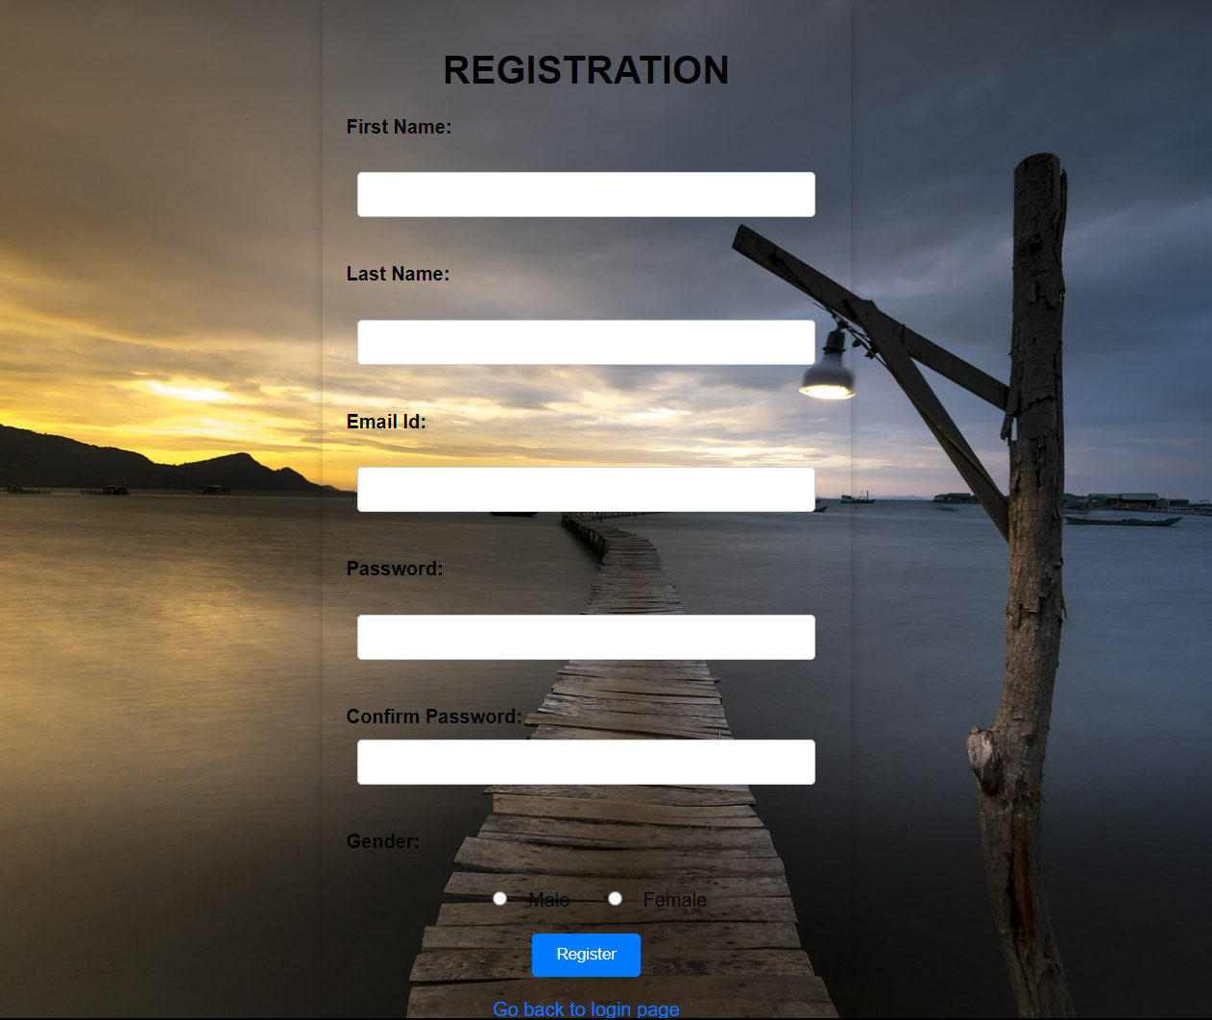

LOGIN/SIGNUP PAGE

Slide 12
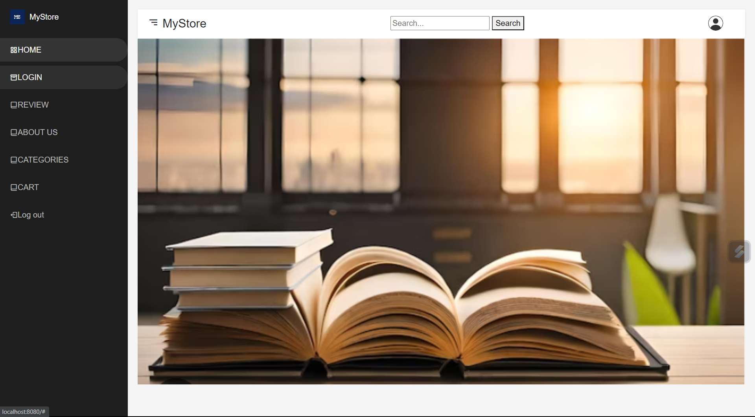
DASHBOARD PAGE

Slide 13

FUTURE SCOPE
The future scope should consider adapting to technological advancements and changing consumer preferences to stay competitive and meet the evolving needs of bookstores and their customers
Expanding the sales channels to include audiobooks, e-books, and print-on-demand services.
Real time information about the inventory will just be a click away which will improve customer service.

Slide 14
CONCLUSION
We have automated the overall management of a store by keeping tabs of inventory, employees, utility making the management of the store a lot more easier.

Slide 15
REFERENCES
https://en.wikipedia.org/wiki/Bookselling
https://www.vskills.in/certification/tutorial/stores-systems-and-procedures/
https://www.feedough.com/importance-of-management-in-business/
https://www.academia.edu/29584781/Book_Store_Management#:~:text=Purpose%20Book%20Store%20Management%20System%20supports%20the%20book,information%2C%20book%20instances%2C%20order%20details%20and%20customer%20details.

Slide 16
THANK YOU

